Slide 1

WQD 7003 Data Analytics
CHAPTER 2 – INTRODUCTION TO DATA WAREHOUSE AND CRISP-DM
Saw Shier Nee, Hema Subramaniam & Aznul Qalid Md Sabri
sawsn@um.edu.my , hema@um.edu.my, aznulqalid@um.edu.my
Dept. of AI, Fac. of Computer Science and IT, University of Malaya
Dept. of SE, Fac. of Computer Science and IT, Universiti Malaya

Slide 2

Outline
Terms in data science
Normalised and Denormalised
Relational database
Data science methodology

Slide 3
Learning Outcomes
At the end of this lecture, student will be able to:
To explain the data analytic concept

Slide 4
Data Science Terminology
Data Warehouse
A logical collection of information gather from many operational databases. It Supports business analytics activities and Decision-making task
Database
An organized grouping of information within a specific structure that needs to be retrieved frequently.
Data Mart
Subsets of data warehouses that is highly focused and isolated for a specific population of users

Slide 5
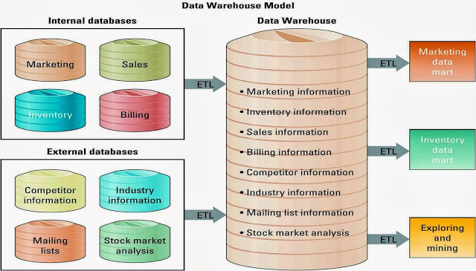
Communication between data

Slide 6
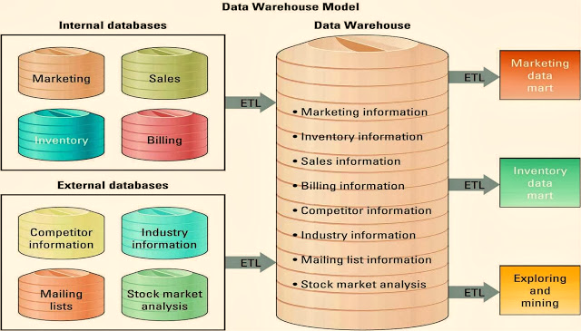
Communication between data.. cont
E- Extract information from internal and external databases
T- Transform the information using common set of enterprise definition
L-Load the information into a data warehouse

Slide 7
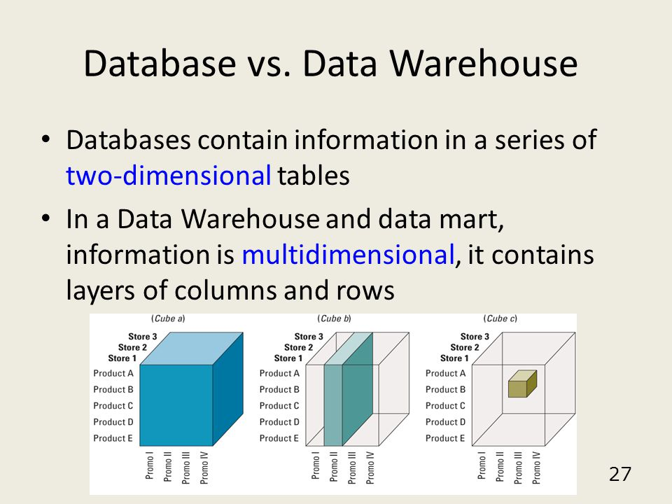
MULTI-DIMENSION INFORMATION
A slice of information displaying Promotion II for all products at all stores.
A slice of information displaying Promotion II for Product B at Store 2.
Store information (layers),
product information (rows),
promotion information (columns)

Slide 8
Comparison
 | Database | Data Warehouse
Purpose | For data retrieval, updating and management | For data analysis and decision making
Systems / Application | OLTP (OnLine Transaction Processing System) | Analytical Software. i.e. data mining tools, reporting tools and OLAP (OnLine Analytical Processing) tools
Format | Normalised Relational database Lowest level of granularity (i.e. individual transactions) | Denormalised and integrated Multi-dimensional arrays or relational format Subject-oriented Granularity level depends on subject
Time Frame | Current / Real time | Historical

Slide 9
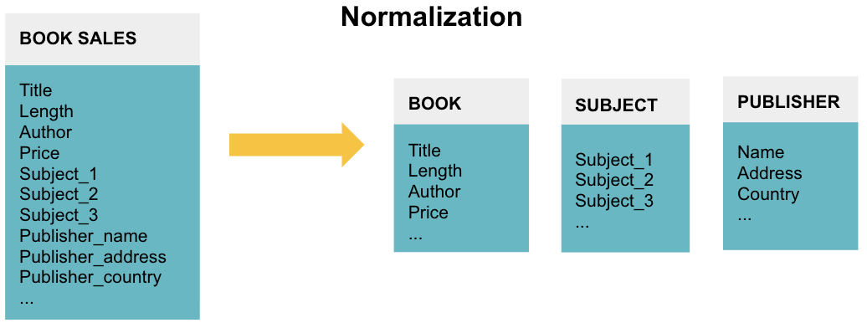
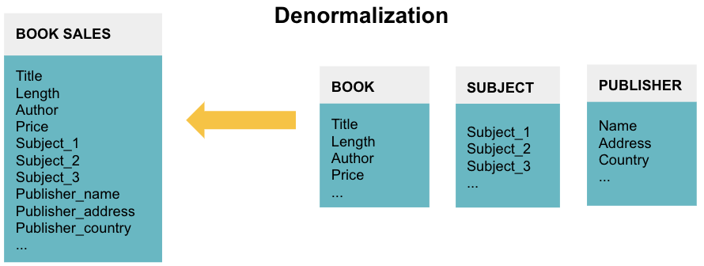
NORMALISED VS DENORMALISED

Slide 10
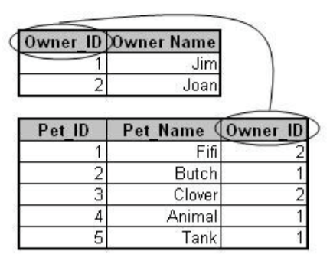
Relational database
A relational database organizes data into tables which can be linked—or related—based on data common to each.
Table 1 contains information about pet owners
Table II contains information about pets
The tables are related by the column Owner_ID.
By relating tables to one another, we can reduce data redundancy and improve database performance.

Slide 11
DATA SET
A data set is a subset of a database or a data warehouse.
It is usually denormalized so that only one table is used.
The creation of a data set may contain several steps, including appending or combining tables from source database tables, or simplifying some data expressions.
Data sets may be made up of a representative sample of a larger set of data, or they may contain all observations relevant to a specific group.

Slide 12
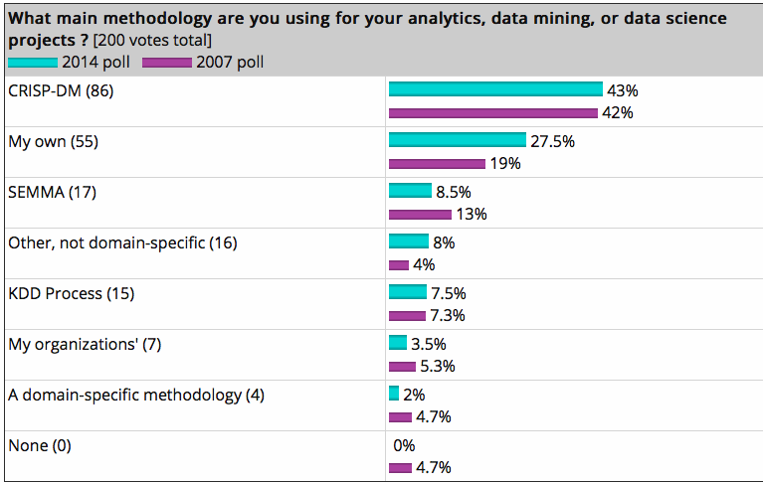
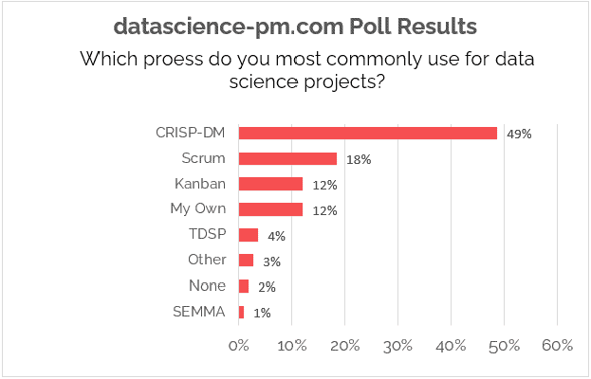
DATA SCIENCE METHODOLOGY
Kdnuggets 2014 polls

Slide 13
CRISP-DM
widely-used analytics model.
The data mining process must be reliable and repeatable by people with little data mining background.
CRoss-Industry Standard Process for Data Mining
An open standard process model that describes common approaches used by data mining experts.

Slide 14
CRISP-DM - HISTORY
Initiative launched in late 1996 by three “veterans” of data mining market.
Daimler Chrysler (then Daimler-Benz), SPSS (then ISL) , NCR
Developed and refined through series of workshops (from 1997-1999).
Published CRISP-DM 1.0 (1999)
Over 200 members of the CRISP-DM SIG worldwide.
Notes:
SIG – special interest group

Slide 15

CRISP-DM - HISTORY
Non-proprietary
Application/Industry neutral
Tool neutral
Focus on business issues and technical analysis
Framework for guidance
Experience base templates for Analysis
Notes:
SIG – special interest group

Slide 16
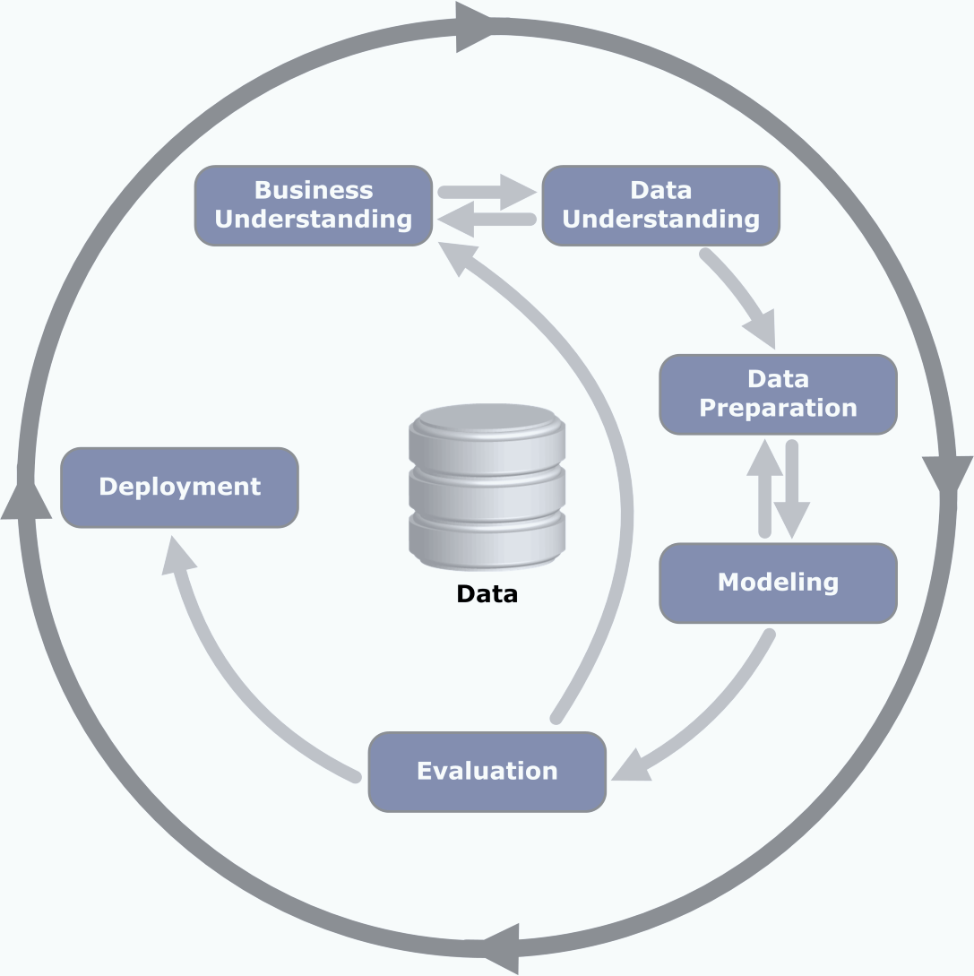
CRISP-DM - HISTORY
The life cycle of a data mining project consists of six phases.
Not rigid process 🡪 moving back and forth between each phase determines which phases has to be performed next.
Notes:
The outer circles symbolizes the cyclical nature of data mining.
Data mining does not end once a solution is deployed
The lesson learn during the process and from the deployed solution can trigger new, more focused business questions

Slide 17
People and roles
Business
Domain
Subject Matter
Commercial
Analytical
Methodologies
What to use and when
Includes the “Data Scientist” role
Data
Management
Structure
Meaning
Technology
Integration
Building apps
Supporting deployment
Includes the “Data Engineer” role
Notes:
The outer circles symbolizes the cyclical nature of data mining.
Data mining does not end once a solution is deployed
The lesson learn during the process and from the deployed solution can trigger new, more focused business questions

Slide 18
Overview of CRISP-DM
Business
Understanding
Data
Understanding
Data
Preparation
Modeling
Evaluation
Deployment
Determine
Business Objectives
Background
Business Objectives
Business Success
Criteria
Situation Assessment
Inventory of Resources
Requirements,
Assumptions, and
Constraints
Risks and Contingencies
Terminology
Costs and Benefits
Determine
Data Mining Goal
Data Mining Goals
Data Mining Success
Criteria
Produce Project Plan
Project Plan Initial Asessment of Tools and Techniques
Collect Initial Data
Initial Data Collection
Report
Describe Data
Data Description Report
Explore Data
Data Exploration Report Verify Data Quality
Data Quality Report
Data Set
Data Set Description
Select Data
Rationale for Inclusion /
Exclusion
Clean Data
Data Cleaning Report
Construct Data
Derived Attributes
Generated Records
Integrate Data
Merged Data
Format Data
Reformatted Data
Select Modeling
Technique
Modeling Technique
Modeling Assumptions
Generate Test Design
Test Design
Build Model
Parameter Settings
Models
Model Description
Assess Model
Model Assessment Revised Parameter Settings
Evaluate Results
Assessment of Data
Mining Results w.r.t.
Business Success
Criteria
Approved Models
Review Process
Review of Process
Determine Next Steps
List of Possible Actions
Decision
Plan Deployment
Deployment Plan
Plan Monitoring and
Maintenance
Monitoring and Maintenance Plan
Produce Final Report
Final Report
Final Presentation
Review Project
Experience
Documentation

Slide 19


Phase 1 – Business Understanding
4 TASKS
Determine business objective
Assess situation
Determine data mining goals
Produce project plan

Slide 20
Phase 1 – Business Understanding
Determine business objectives
Assess situation
Determine data mining goals
thoroughly understand, from a business perspective, what the client really wants to accomplish
uncover important factors, at the beginning, that can influence the outcome of the project
neglecting this step is to expend a great deal of effort producing the right answers to the wrong questions
more detailed fact-finding about all of the resources, constraints, assumptions and other factors that should be considered
flesh out the details
Produce project plan
a business goal states objectives in business terminology
a data mining goal states project objectives in technical terms
E.g.
Business goal: “Increase catalog sales to existing customers.”
Data mining goal: “Predict how many widgets a customer will buy, given their purchases over the past three years, demographic information (age, salary, city) and the price of the item.”
describe the intended plan for achieving the data mining goals and the business goals
the plan should specify the anticipated set of steps to be performed during the rest of the project including an initial selection of tools and techniques
Notes:
Reference: https://the-modeling-agency.com/crisp-dm.pdf

Slide 21

Phase 2 – Data Understanding
Verify data quality
Explore data
Describe data
Collect data
Notes:
The data understanding phase of CRISP-DM involves taking a closer look at the data available for mining. Data understanding involves accessing the data and exploring it using tables and graphics. Starts with an initial data collection and proceeds with activities in order to get familiar with the data, to identify data quality problems, to discover first insights into the data or to detect interesting subsets to form hypotheses for hidden information.

Slide 22
Phase 2 – Data Understanding
Collect initial data
acquire the data listed in the project resources
includes data loading if necessary, for data understanding
possibly leads to initial data preparation steps
Notes: if acquiring multiple data sources, integration is an additional issue, either here or in the later data preparation phase
Describe data
examine the “gross” or “surface” properties of the acquired data
report on the results

Slide 23
Phase 2 – Data Understanding
Explore data
tackles the data mining questions, which can be addressed using querying, visualization and reporting including:
distribution of key attributes, results of simple aggregations
relations between pairs or small numbers of attributes
properties of significant sub-populations, simple statistical analyses
may address directly the data mining goals
may contribute to or refine the data description and quality reports
may feed into the transformation and other data preparation needed

Slide 24
Phase 2 – Data Understanding
Verify data quality
examine the quality of the data, addressing questions such as:
“Is the data complete?”,
Are there missing values in the data?”

Slide 25

Phase 3 – Data Preparation
Format data
Integrate data
Construct data
Clean data
Select data

Slide 26
Phase 3 – Data Preparation
Select data
decide on the data to be used for analysis
criteria include relevance to the data mining goals, quality and technical constraints such as limits on data volume or data types
covers selection of attributes as well as selection of records in a table
Clean data
raise the data quality to the level required by the selected analysis techniques
may involve selection of clean subsets of the data, the insertion of suitable defaults or more ambitious techniques such as the estimation of missing data by modeling.

Slide 27
Phase 3 – Data Preparation
Construct data
constructive data preparation operations such as the production of derived attributes, entire new records or transformed values for existing attributes
Integrate data
methods whereby information is combined from multiple tables or records to create new records or values
Format data
formatting transformations refer to primarily syntactic modifications made to the data that do not change its meaning, but might be required by the modeling tool

Slide 28

Phase 3 – Data Preparation
Assess model
Build model
Design the test
Select modeling technique

Slide 29
Phase 4 – Modelling
Select the modeling technique (based upon the data mining objective)
Build model (Parameter settings)
Assess model (rank the models)
Various modeling techniques are selected and applied and their parameters are calibrated to optimal values.
Some techniques have specific requirements on the form of data.
Therefore, stepping back to the data preparation phase is often necessary.

Slide 30
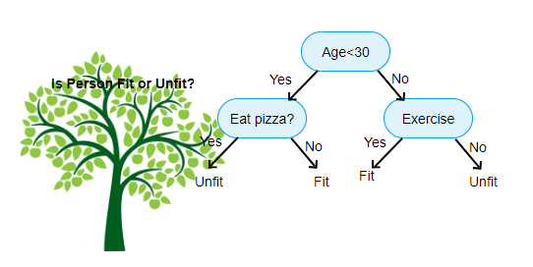
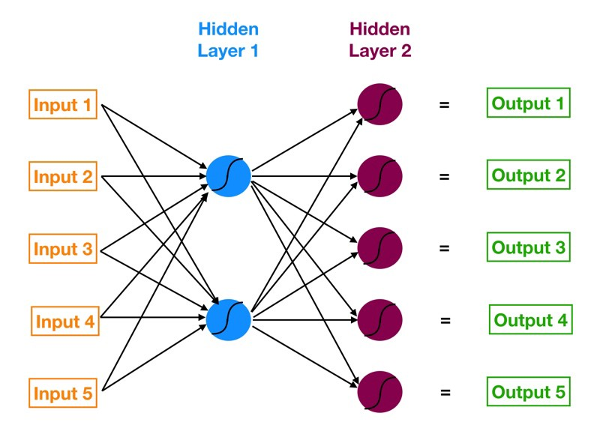
Phase 4 – Modelling
Select modelling technique
Generate test design
Build model
Assess model
select the actual modeling technique that is to be used
i.e. decision tree, neural network
if multiple techniques are applied, perform this task for each techniques separately
‹#›

Slide 31
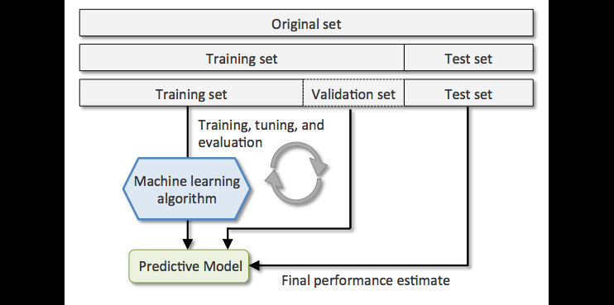
Phase 4 – Modelling
Select modelling technique
Generate test design
Build model
Assess model
before actually building a model, generate a procedure or mechanism to test the model’s quality and validity
i.e. In classification, it is common to use error rates as quality measures for data mining models. Therefore, typically separate the dataset into train and test set, build the model on the train set and estimate its quality on the separate test set

Slide 32
Phase 4 – Modelling
Select modelling technique
Generate test design
Build model
Assess model
run the modeling tool on the prepared dataset to create one or more models

Slide 33
Phase 4 – Modelling
Select modelling technique
Generate test design
Build model
Assess model

Slide 34
Phase 4 – Modelling
interprets the models according to his domain knowledge, the data mining success criteria and the desired test design
judges the success of the application of modeling and discovery techniques more technically
contacts business analysts and domain experts later in order to discuss the data mining results in the business context
only consider models whereas the evaluation phase also takes into account all other results that were produced in the course of the project

Slide 35

Phase 5 – Evaluation
Determine the steps
Review process
Evaluate the result

Slide 36
Phase 5 – Evaluation
Evaluate results
assesses the degree to which the model meets the business objectives
seeks to determine if there is some business reason why this model is deficient
test the model(s) on test applications in the real application if time and budget constraints permit
also assesses other data mining results generated
unveil additional challenges, information or hints for future directions

Slide 37
Phase 5 – Evaluation
2. Review process
do a more thorough review of the data mining engagement in order to determine if there is any important factor or task that has somehow been overlooked
review the quality assurance issues
i.e. “Did we correctly build the model?”

Slide 38
Phase 5 – Evaluation
3. Determine next steps
decides how to proceed at this stage
decides whether to finish the project and move on to deployment if appropriate or whether to initiate further iterations or set up new data mining projects
include analyses of remaining resources and budget that influences the decisions

Slide 39

Phase 5 – Evaluation
Review project
Final report
Plan monitoring and maintenance
Plan deployment

Slide 40
Phase 6 – Deployment
Plan deployment
in order to deploy the data mining result(s) into the business, takes the evaluation results and concludes a strategy for deployment
document the procedure for later deployment
Plan monitoring and maintenance
important if the data mining results become part of the day-to-day business and its environment
helps to avoid unnecessarily long periods of incorrect usage of data mining results
needs a detailed on monitoring process
takes into account the specific type of deployment

Slide 41
Phase 6 – Deployment
Produce final report
the project leader and his team write up a final report
may be only a summary of the project and its experiences
may be a final and comprehensive presentation of the data mining result(s)
Review project
assess what went right and what went wrong, what was done well and what needs to be improved

Slide 42
Related Videos / Reference
IBM Report on CRISP-DM
https://www.ibm.com/docs/en/spss-modeler/saas?topic=dm-crisp-help-overview
Introduction to the CRISP-DM Methodology (Analytics & Data Science) - Youtube Video
https://www.youtube.com/watch?v=q_okDS2RtzY

